Slide 1
Supply Chain Management Strategy
Coursera- Supply Chain Management Specialization

Slide 2
Introduction
Medical Technologies Corporation (MTC) is a medical equipment manufacturing company with its headquarters in Collegeville, Pennsylvania.
The Affordable Care Act (ACA) implemented an excise tax on medical devices (2.3% of revenues) which is expected to drag down average industry profit margins, (8.8% of revenue in 2015) unless the industry finds a way to dampen the impact of the legislation.
Goal is to come up with costs savings large enough to cover the newly-imposed Affordable Care Act (ACA) Medical Device Excise Tax of 2.3% of revenue.

Slide 3
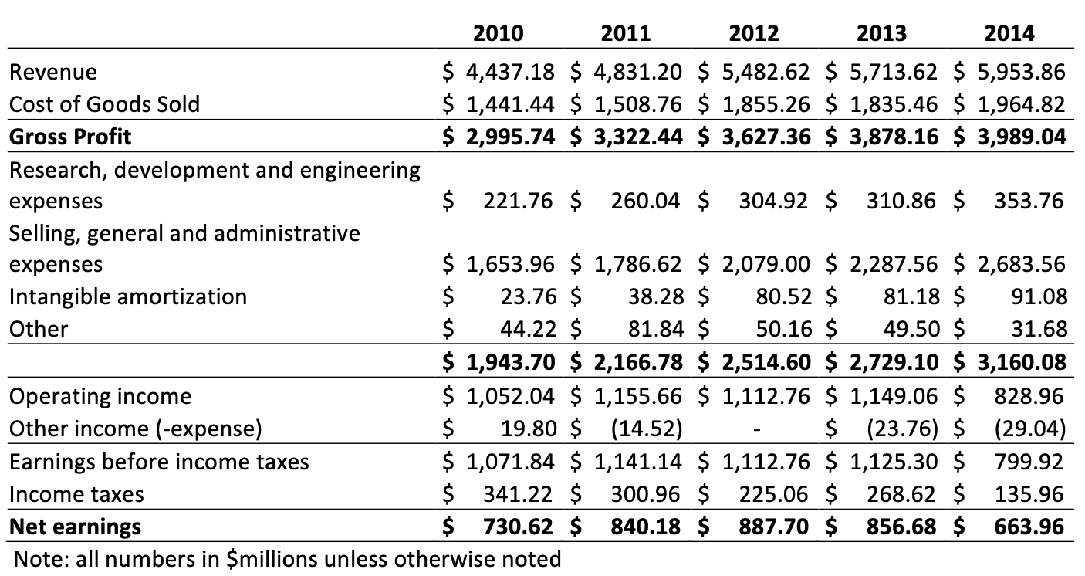
Objective
To create a cost saving plan to reduce the impact of the newly-imposed Affordable Care Act (ACA) Medical Device Excise Tax of 2.3% of revenue.

Slide 4
Stakeholders
﻿﻿MTC
Board of Directors
Sales Representatives
﻿﻿﻿Distributors
﻿﻿﻿3PL
﻿﻿﻿Hospital Group Purchasing Organisations
Doctors and Hospital Administration

Slide 5
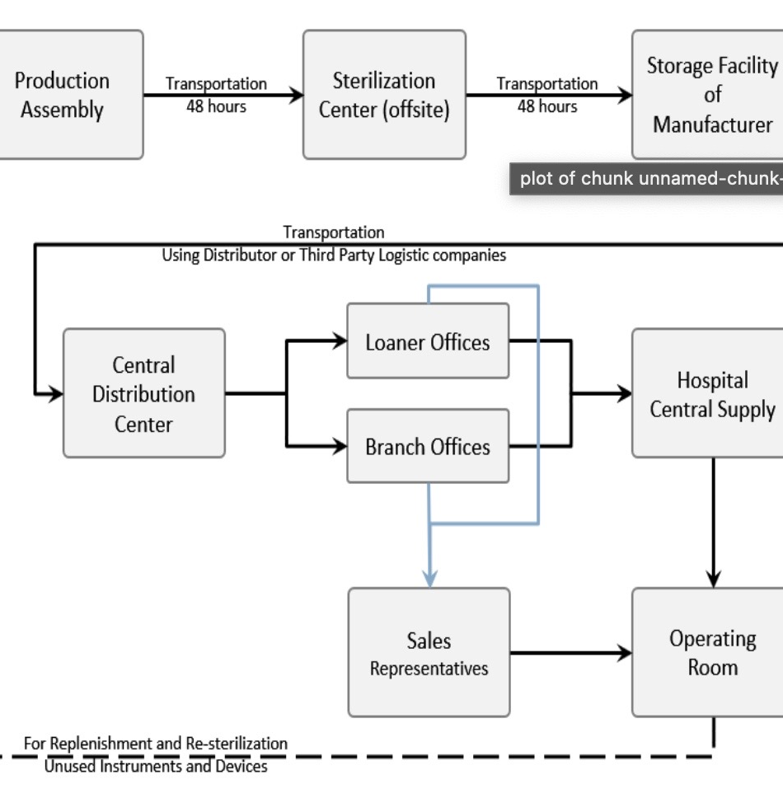
Logistics Network

Slide 6
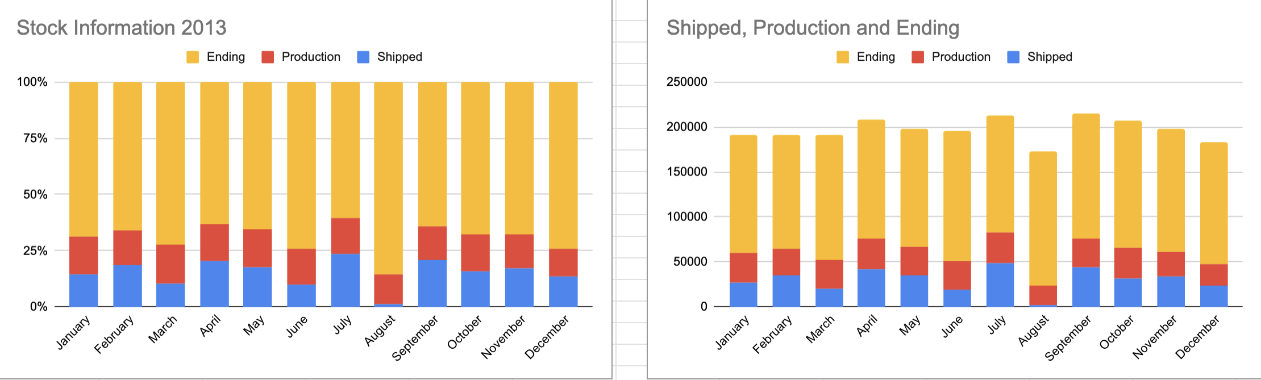
Planning
Insight into the production, shipped and start-end levels of MTC for 2013 and 2014
Making inferences from the charts, we can deduce that the initial inventory is quite high and in comparison the shipped quantity is low leading to high inventory levels.
These levels also see an increase due to higher production values than shipped values.
These high inventory levels are unnecessary and should be reduced effectively and production should be reduced till satisfactory inventory levels are achieved.

Slide 7
Supply Chain Sourcing
Solution
MTC should be a strategic supplier for major hospital groups since this means an establishment of trust in their logistics and supply chain network and the ability of MTC to provide excellent delivery and products without lags.
Behaviour of Strategic Suppliers:
fast delivery times
fast issue response and problem redressal times
high levels of mutual trust
high quality of products
no delivery lags and issues
collaboration with customer on delivery requirements
bonuses/ incentives and discounts for strategic partners

Slide 8
Off site sterilisation strategy: Pros and Cons
Off-site
One large site that is centrally supervised leading to better output and operations
high transportation costs, delivery delays and lags. Not readily available products.
On-site
smaller sites
large number of smaller sites and low control on output
large labour costs on multiple sites
fast response times
readily available products
MTC should use a hybrid strategy where on site sterilisation should be used with strategic partners and off-site should be used for all other customers

Slide 9
Thank you.

